Slide 1
SmartPlant 3D Drawings

Slide 2
Drawings and Reports
Administrator’s Workflow
Drawings
  Volume Drawings
  Snapshot Drawings
  Drawings by Query
Dimensioning and Labeling
  Manual Labeling and Dimensioning
  Automatic Labeling and Dimensioning
View Styles
  Graphic Rules
  Label Rules
  Dimension Rules

Slide 3
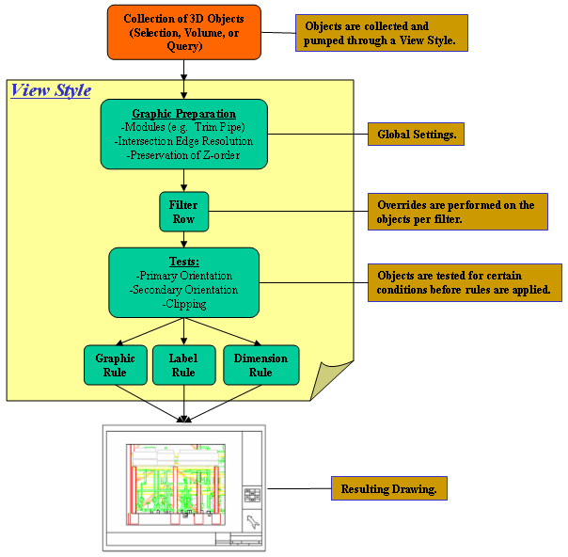
Overview

Slide 4
Administrator’s Workflow
Setup
  Enable batch
  Enable error logging
Management
  Create hierarchy of folders and drawing types
  Set drawing type level properties
  Setup Drawing Grids (optional)
Drawing Style Setup
  Edit Border Templates
  Edit Styles.sha to create new line styles and dimension styles
  Create if necessary Drawings Filters to select objects to resym / label
  Create view styles for volume and snapshot drawings

Slide 5
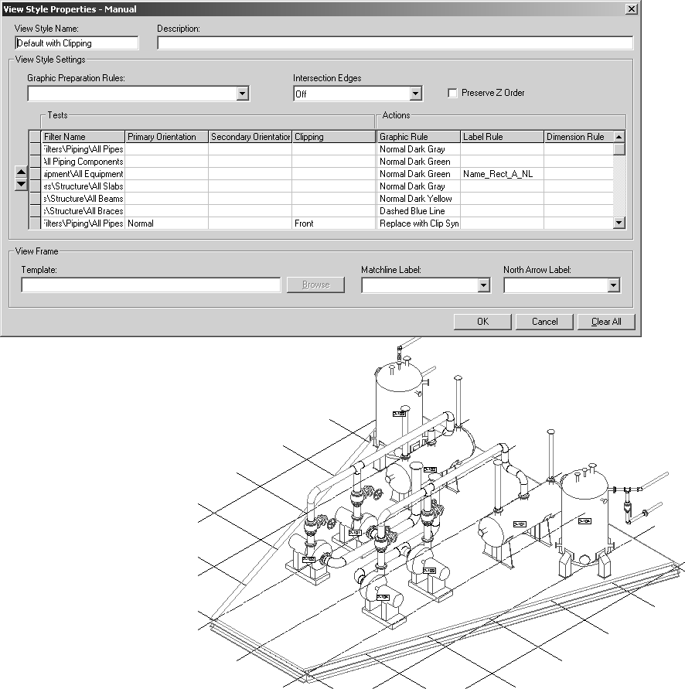
Drawing View Style Example

Slide 6
Volume Drawings
Used where many drawings similar to each other to be produced (e.g. plans, elevations etc)
Each drawing in a type has same view arrangement and view properties
Four ways of volume placement – two points, four points, view and selection
Independent of workspace definition – only the volume range is considered
View style acts as “include” – only those objects from the volume mentioned in the view style end up on drawing with the symbology therein

Slide 7
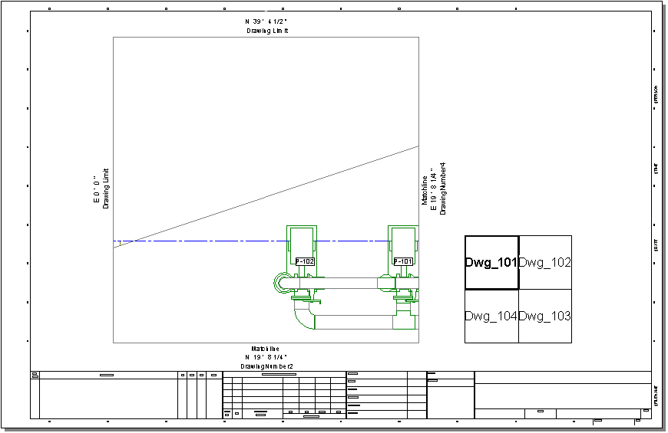
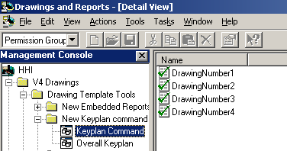
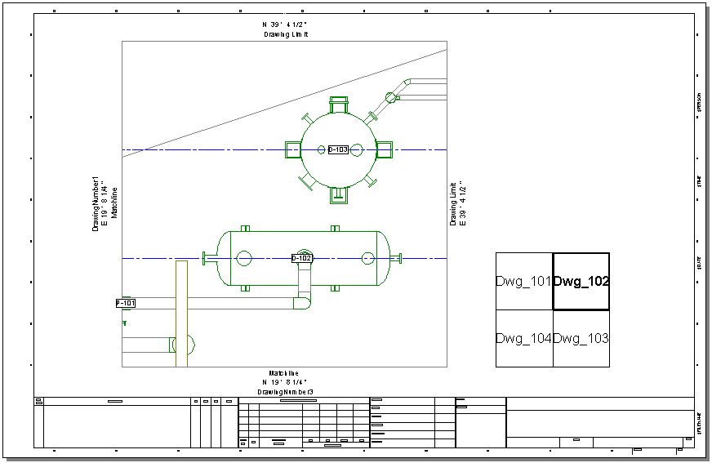
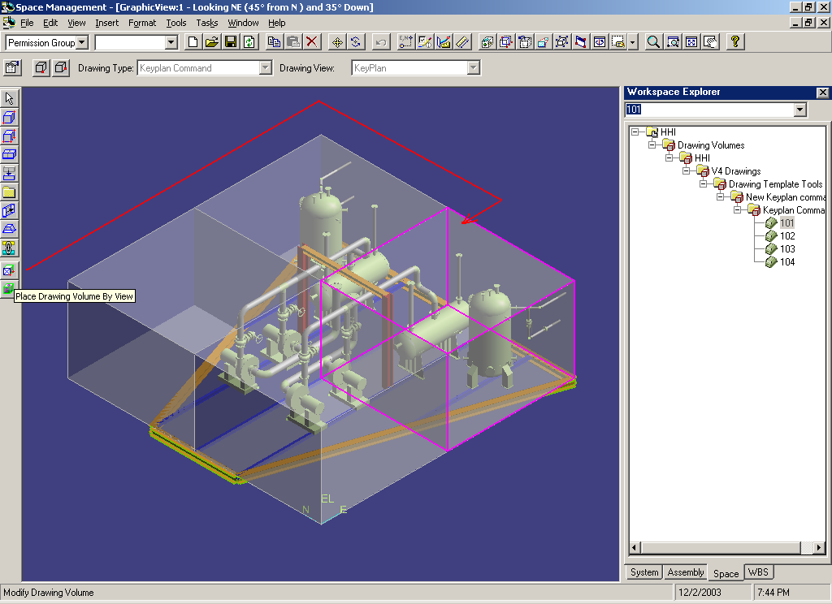
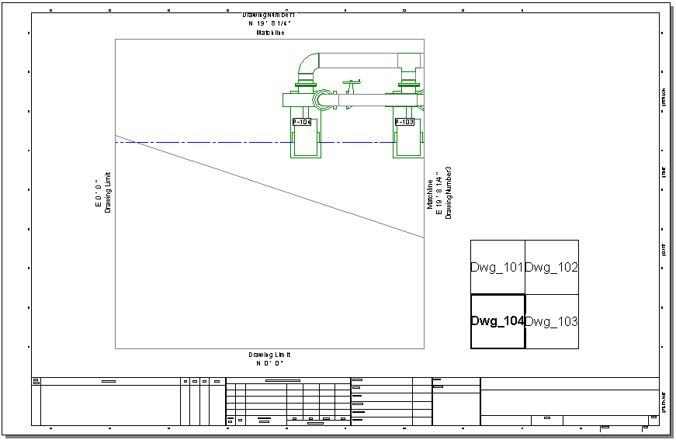
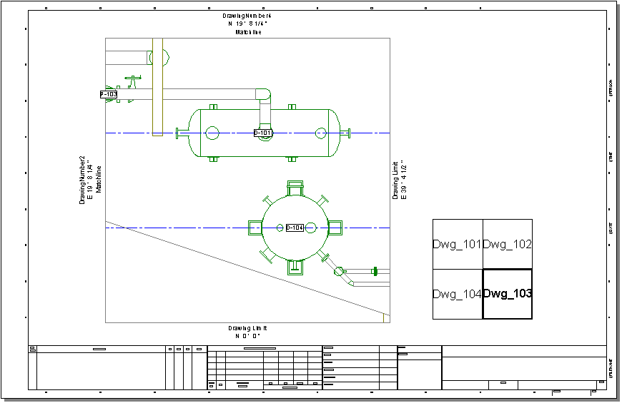
Drawings by Volume Placement

Slide 8
Drawing with a Keyplan

Slide 9
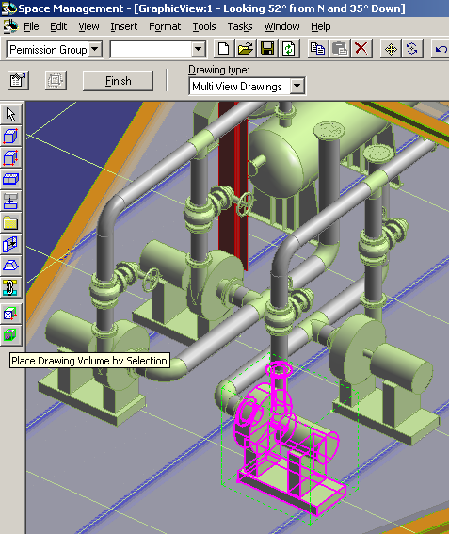
Drawing Volumes by selection

Slide 10
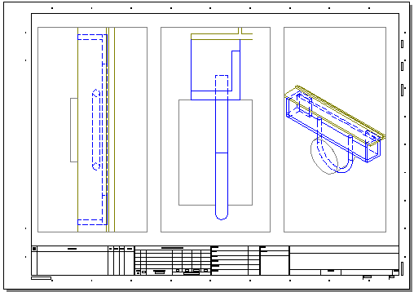
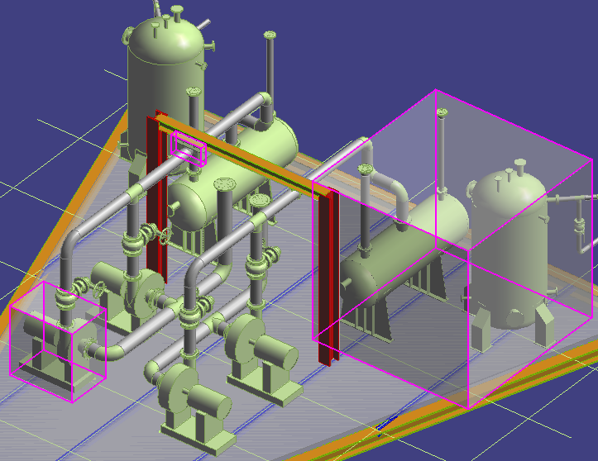
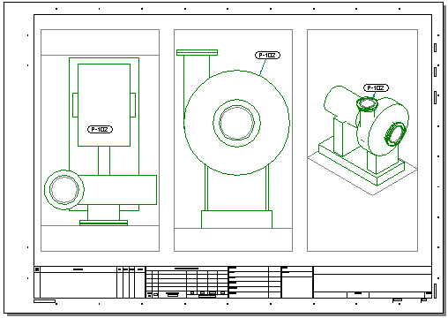
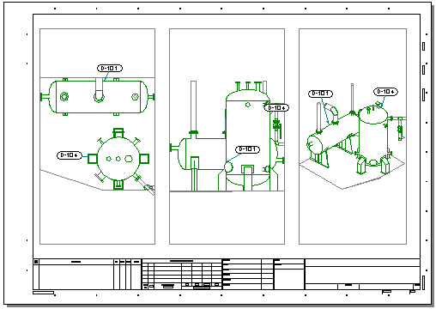
Multiple views for one volume

Slide 11
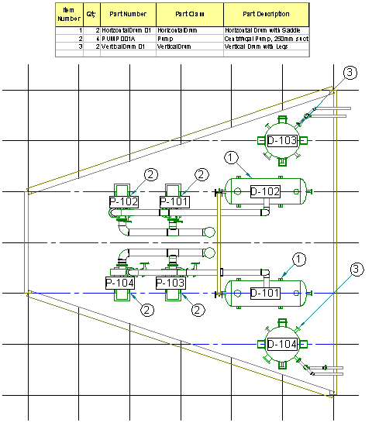
Drawing View Reports

Slide 12
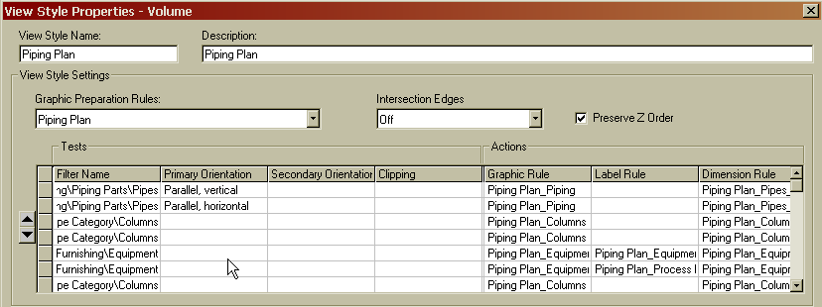
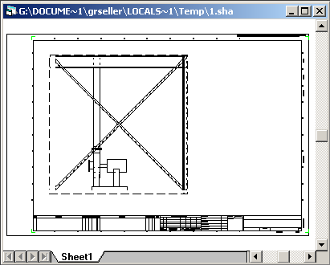
Volume Drawing Processing
This is a drawing volume. It is basically a query of all the objects that have been created in the DB which currently reside inside its borders. The objects do not have to be visible or even in your current workspace.
1
2
At drawing creation time, the objects from the volume query are checked against the list of filters in the view style.
The priority is from the Top down, so if an object finds its match in several different filters, the last one (bottom most) wins.
If an object finds its match in one of the view style filters, then the specific rules for that row are applied.
3
If an object does not find its match in the view style filters, it does not end up on the drawing view.

Slide 13
Volume Drawing Pros/cons
Can change volume size/location after placement
Do not have to worry about workspace
Place once for one drawing type – copy to another drawing type
Can override properties for a single drawing – e.g. different size or scale of view
Limited to standard orientations – plan, four elevations and four isometrics

Slide 14
Volume Drawings Workflow
Administrator Workflow (in Drawings task)
  Create drawing type in hierarchy
  Setup drawing template
  Define the drawing view(s) size and scale on sheet
  Define view orientation(s)
  Set style for view(s)
  Define key plan (optional)
  Define embedded report (optional)
Designer Workflow (in Space Management task)
  Select drawing type
  Place volume by view(if single view), 2 points, 4 points or selection (one or more views)
Designer Workflow (in Drawings task)
  Create drawings for the drawing type for which volumes are placed
  Set drawing level properties if needed
  Update drawing
  Manually add additional Labels and Dimension if needed

Slide 15
Snapshot Drawings
Used where drawing layout is different for each drawing (e.g. one drawing containing views showing different parts of 3D)
Each drawing is independent regarding view arrangement and view properties
Each view is individually saved (snapshot) and composed on a drawing
Preserves workspace definition at the time of snapshot – both workspace and range considered
View style acts as “override” – everything in workspace ends up on drawing in default symbology, everything mentioned in view style follows symbology therein

Slide 16
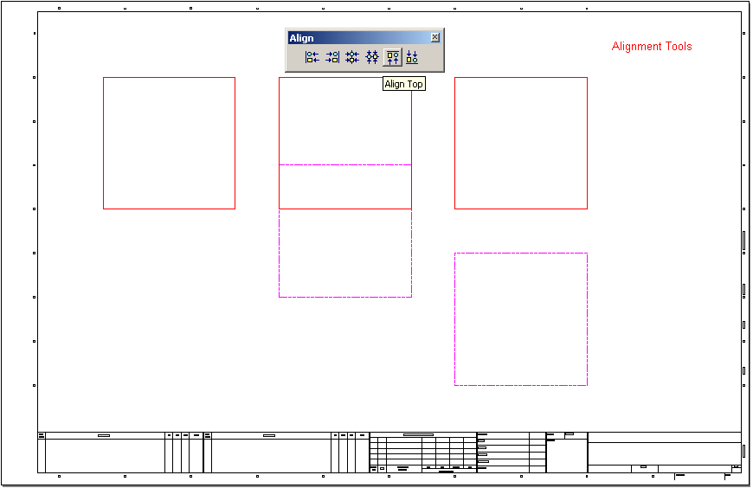
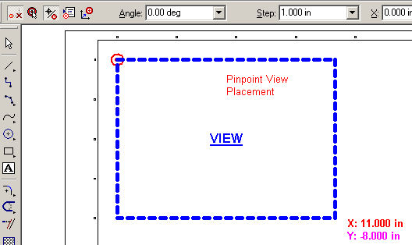
View Placement Tools

Slide 17
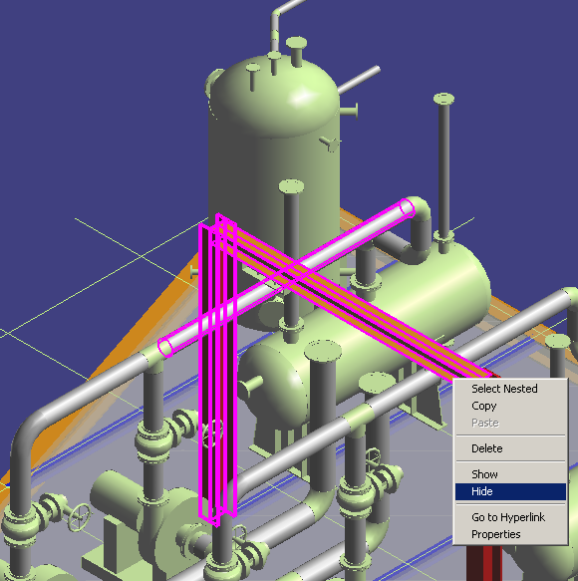
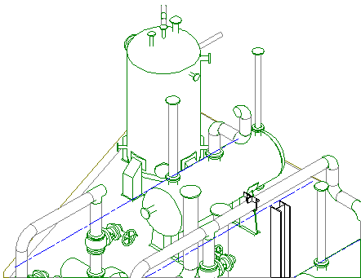
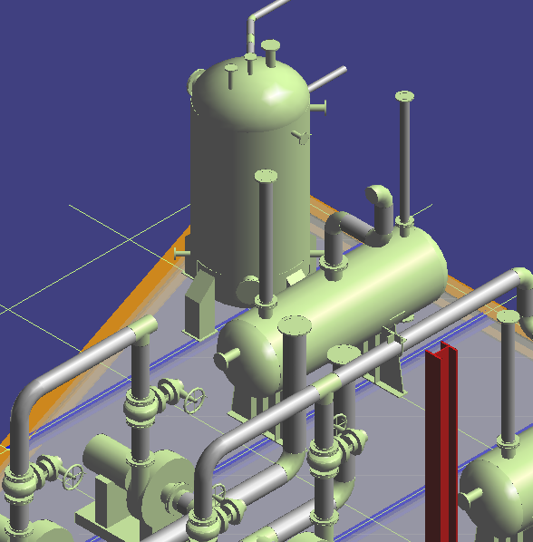
Snapshot drawings with hide support

Slide 18
Snapshot Drawing Pros/cons
Any layout of views is possible on a given drawing
Arbitrary view orientations are possible
Composite views can be simulated by appropriate workspace definition
Hide/select set support gives more flexibility
Cannot change volume definition after snapshot
Each drawing must be individually composed

Slide 19
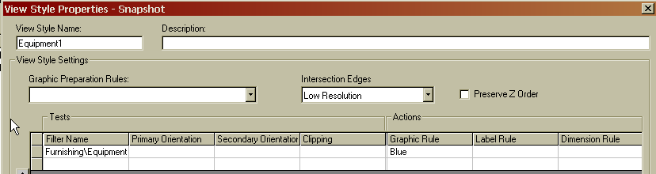
Snapshot Drawing Processing
This is a manual drawing volume. It is basically a query of all the objects that were in your workspace when the view/volume was created.
1
At drawing creation time, the objects from the volume query are checked against the list of filters in the view style.
2
It is implied that all the objects that were in the graphic view at creation time will get a basic VHL graphic rule applied. Think of it as the first row of the View Style dialog where the filter is everything from the volume and a simple VHL rule is applied. Then overrides are processed in order.
If an object finds its match in one of the view style filters, then the specific rules for that row will override the general setting.
3
All objects will end up on the drawing view regardless of whether or not they find a match.

Slide 20
Snapshot Drawings Workflow
Administrator Workflow (in Drawings task)
  Create Drawing Type in Hierarchy
Designer Workflow (in any 3D task)
  Define workspace to include objects desired on drawing
  Hide objects to be excluded
  Select objects to be included (if using select set mode)
  Orient 3D view
  Snapshot drawing view(s) (assign drawing type and view style)
Designer Workflow (in Drawings task)
  Create a drawing (choose template)
  Place drawing view(s) – compose drawing
  Update document
  Manually add additional Labels and Dimension if needed

Slide 21
Drawings By Query
What Drawing Types will this support?
    Any drawing that documents many objects in the model the same way (e.g. Piping Iso’s, Hangers, Equipment, etc…).
  Why do we need this?
    Without it, you would have to place hundreds of drawing volumes to document each type of part or assembly.
  What are the benefits?
    No physical volumes. The software uses the query to collect all the objects and then wraps them up on-the-fly.

Slide 22
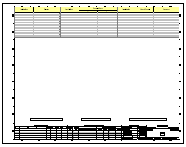
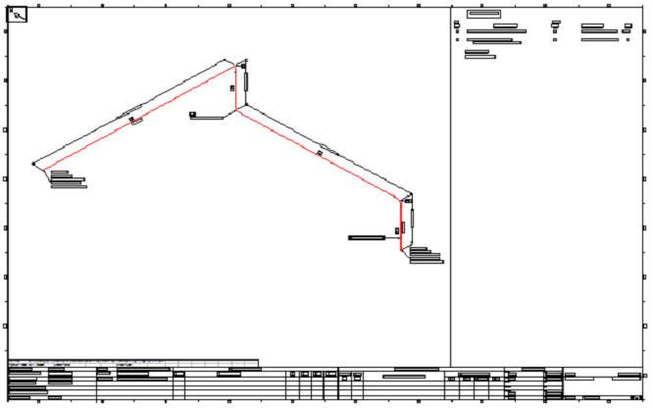
Drawings by Query
ADMINISTRATIVE SETUP
BY QUERY MANAGER
What do you want to document?
Where do you want to look?
Template
Filter
that answers
the “Where” question.
Drawing Package
Filter
Defining “What”
Drawing Package

Slide 23
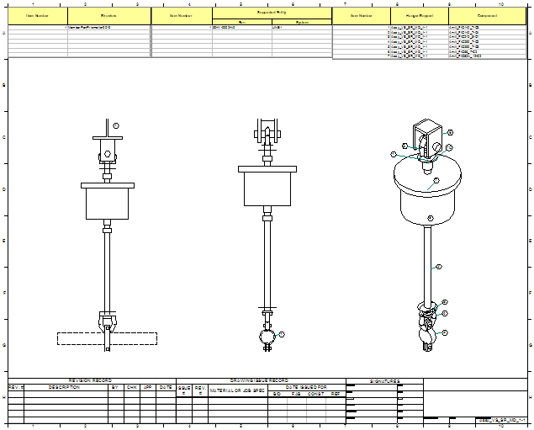
Drawings By Query – Example

Slide 24
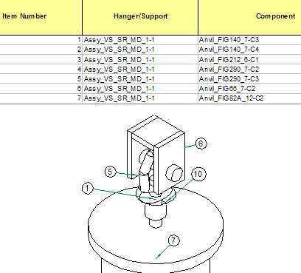
Drawings By Query – Example

Slide 25
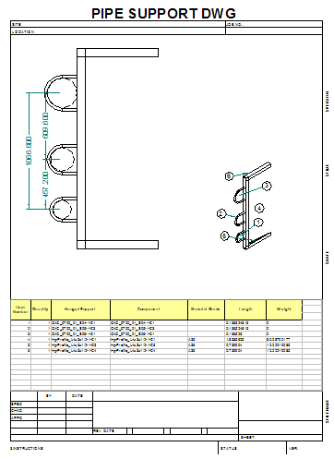
Drawings By Query – Example

Slide 26
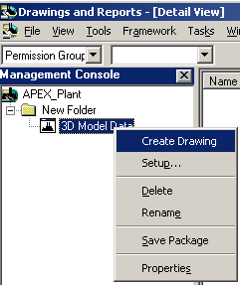
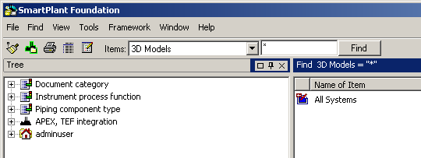
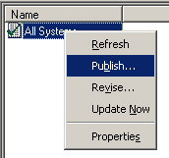
3D Model Data Publishing

Slide 27
Dimensioning and Labeling
Manual Labeling
Manual Dimensioning
Automatic Labeling (Label Rules)
Automatic Dimensioning (Dimension Rules)

Slide 28
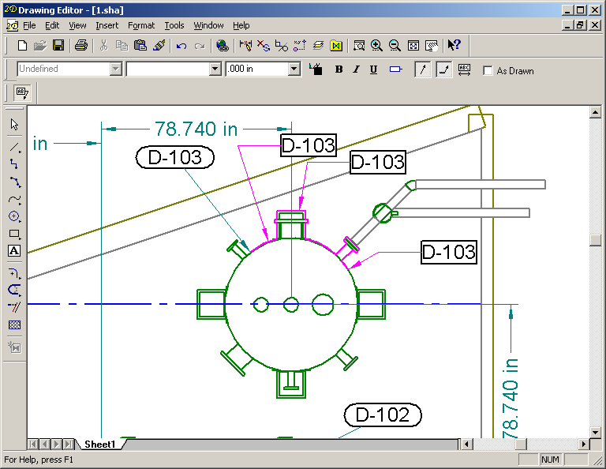
Manual Labeling

Slide 29
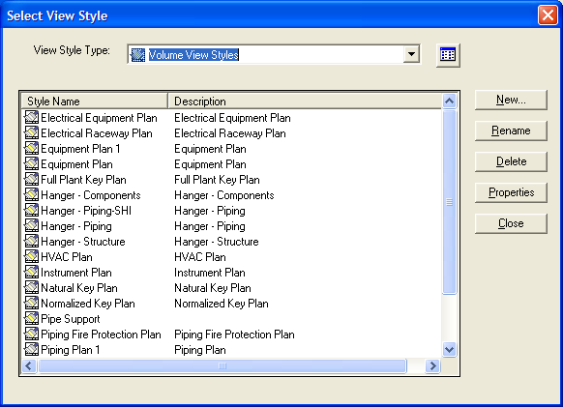
View Styles

Slide 30
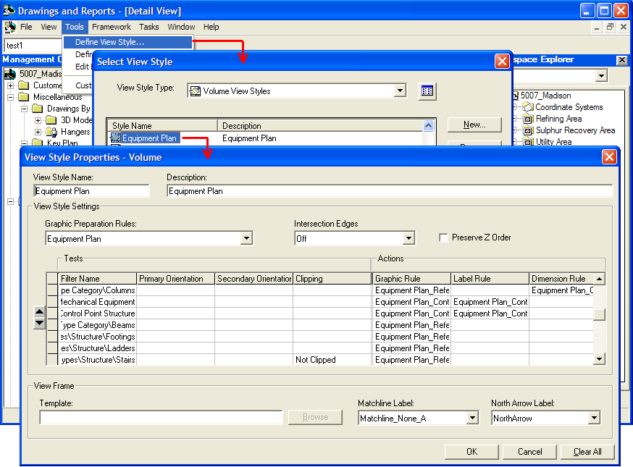
View Styles

Slide 31
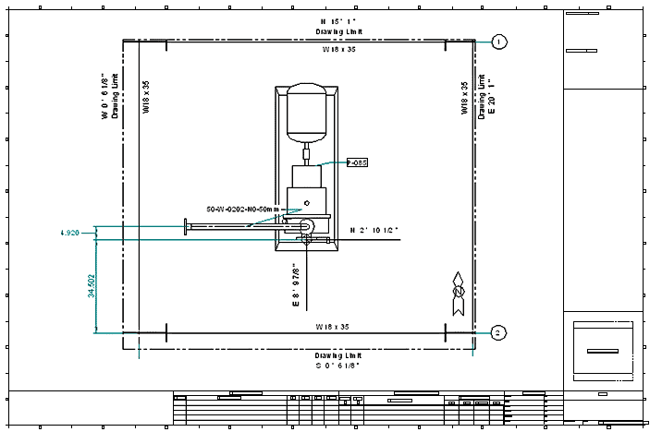
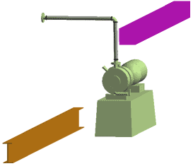
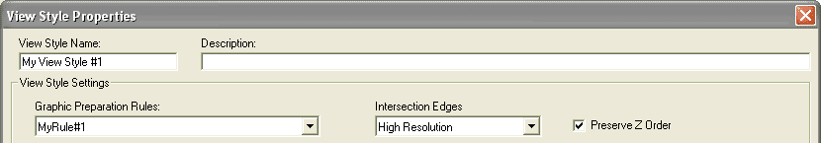

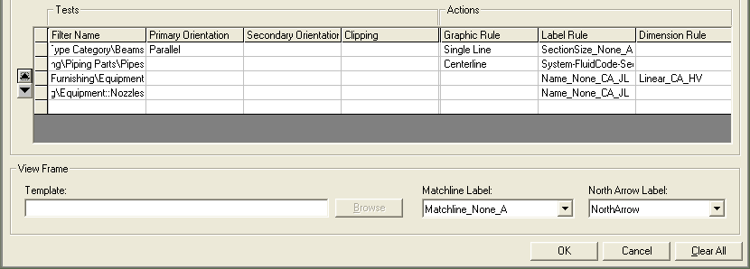
Template
Properties
1. Look Plan
2. Use View Style
3. ¼” = 1’
Objects Funneled Through the View Style
Final Drawing
We can manipulate the objects before they are tested and annotated.
Pipe Surface Trimmer
Nozzle Separator
Discard
Single Line

Slide 32
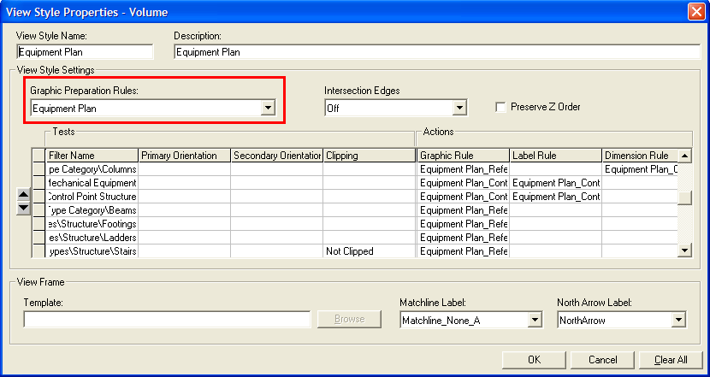
Graphic Preparation Rules

Slide 33

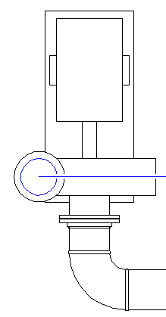
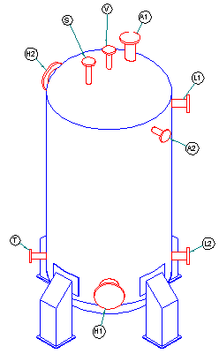
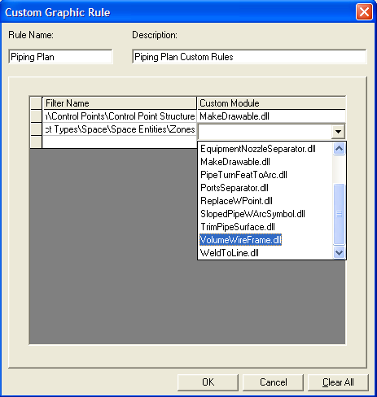
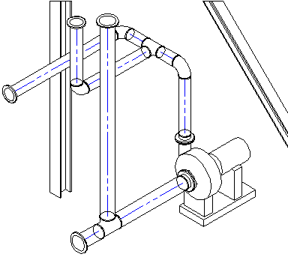
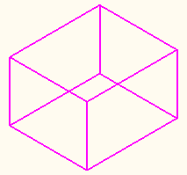
Graphic Preparation Rules

Slide 34
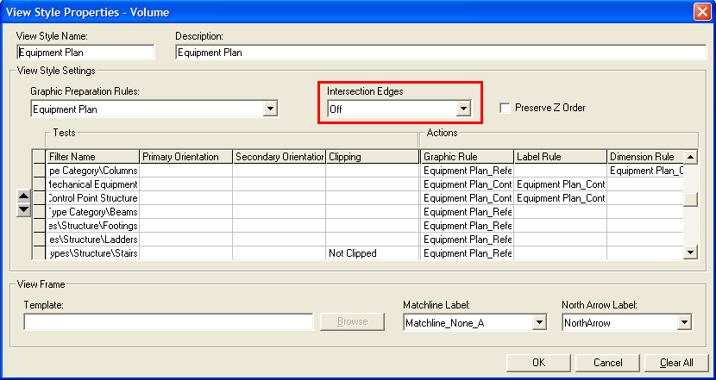
Intersection Edges

Slide 35

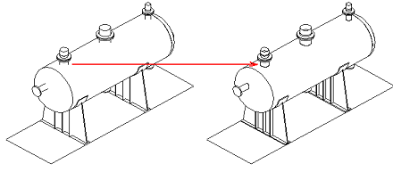
Intersection Edges

Slide 36
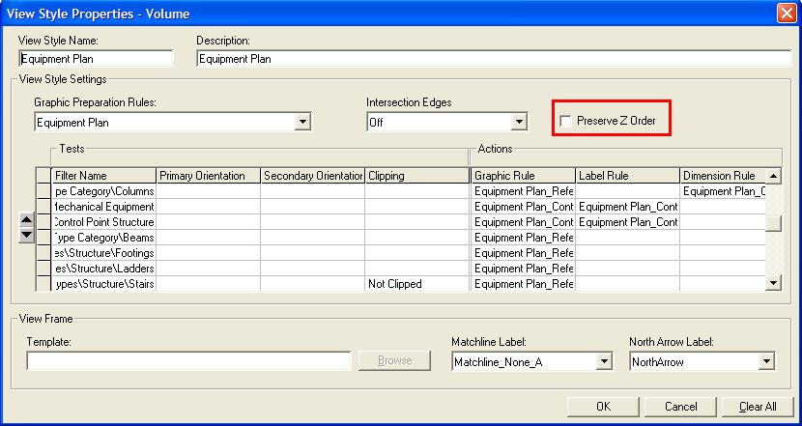
Preserve “Z” Order

Slide 37


Preserve “Z” Order

Slide 38
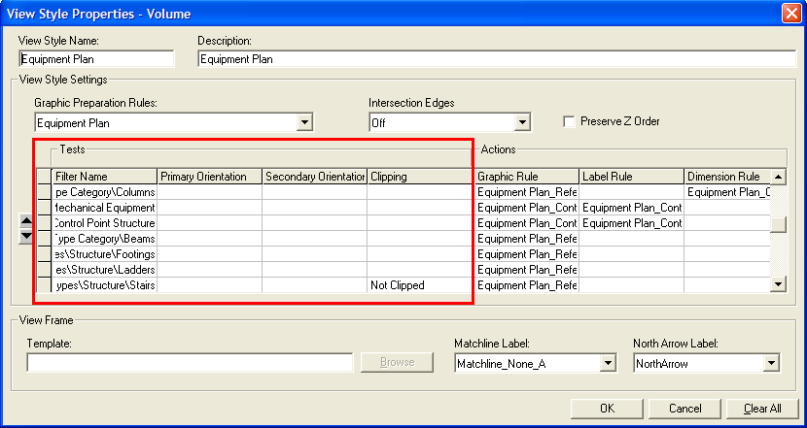
Tests

Slide 39
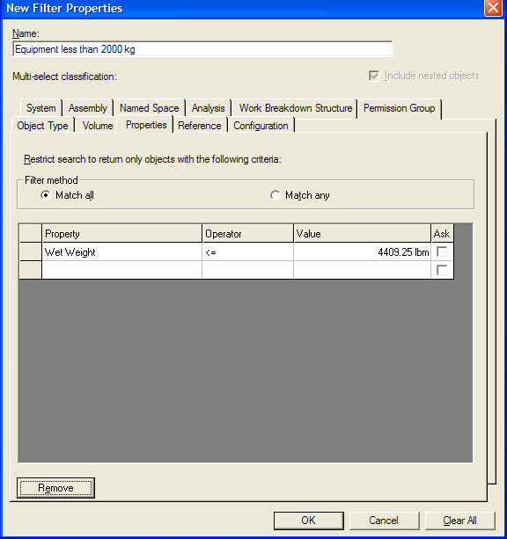
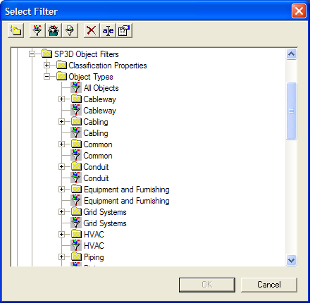
Filters
We deliver filters for all object types.
Filter by properties
(=, <, >, <=, >=, Contains, etc…)

Slide 40
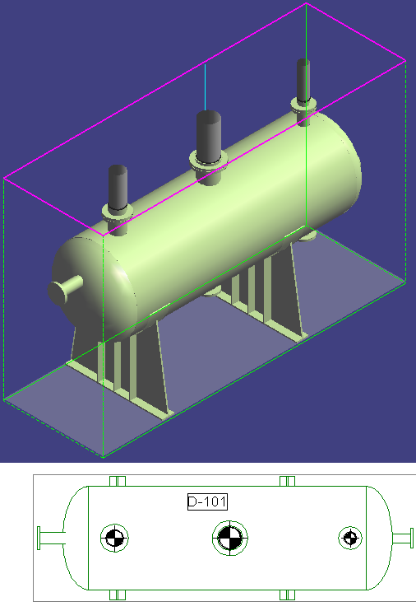


Tests (Orientation and Clipping)
Replace w/ Symbol Rule (parametric)

Slide 41

Actions

Slide 42

Actions - Graphic Rules

Slide 43





Actions - Graphic Rules

Slide 44

Actions – Graphic Rule Line Styles

Slide 45

Actions - Label Rules

Slide 46

Actions - Label Rules
Labels found clear space

Slide 47

Actions - Dimension Rules

Slide 48

Actions - Dimension Rules
Pipe to Pipe
Anchored to Column Lines

Slide 49

Actions - Dimension Rules
Dimensions pushed to margin

Slide 50

RAD Dimension Styles

Slide 51

Example – Piping Plan

Slide 52

Example - Piping Plan
Pipe Labels
Equipment Labels
Structure as reference style
Grid Labels
Matchlines
Key Plan
North Arrow
Dimensions

Slide 53

Example - Piping Plan

Slide 54


Key Plan
This command is new in the Drawings Environment. It follows the View Style paradigm.

Slide 55




Key Plan

Slide 56

Key Plan
The Type selection filters the grid.
This shows a list of Coordinate Systems in the Model.
This is the range to display beyond the highlighted volume.

Slide 57

Key Plan
This is a delivered label. It centers the volume name.
This is what I call a pseudo filter. There is another one called “KEY_PLAN_ADJACENT_ELEMENT”. It allows you to set the symbology for the surrounding volumes (if this were a Natural or Normalized type).

Slide 58

Key Plan

Slide 59

Key Plan
Each view can have multiple key plans. This was mainly developed to support Technip Offshore drawings.
Each key plan can have a different range and style.

Slide 60

Blobbing of Drawings to Model DB
Drawing files are copied to the %temp% directory while in use. When finished, they are blobbed to the Model DB. This helps with migration.
Model DB

